Slide 1

Power BI Git-ting CI/CD
Kristyna Ferris

Slide 2


About Me ~ Kristyna Ferris
Senior data engineer consultant at 3Cloud, Lexington Data Technology Group organizer , author on DataOnWheels, co-founder of Data On Rails, and co-host on Wednesday Lunch & Learn YouTube livestream.
My experience includes implementing and managing enterprise-level Power BI instances, training teams on reporting best practices, learning new coding languages to hack into Power BI, and building templates for scalable analytics.
Check out my blog: https://dataonwheels.wordpress.com/
Check out my blog platform: https://dataonrailsblog.wordpress.com/
Connect on LinkedIn: https://www.linkedin.com/in/kristyna-hughes-dataonwheels/
Connect on Twitter: @data_dragoness
GitHub

Slide 3
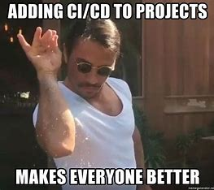
What is Git?
Source control management
Enables collaboration
Captures version history
Continuous integration and continuous development (CI/CD)

Slide 4
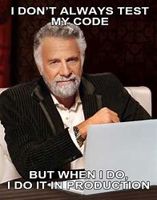
Why do we need CI/CD?
CI/CD stands for continual integration and continual development
Report design is never done, as the business changes and evolves so should the reporting
But do we really need to do all this? I mean I tested enough before I published the report

Slide 5
Code for Future You
Unfortunately, nobody is perfect
Stakeholders change their minds
The power of CI/CD lies within the ability to make a copy of your code (or report) to develop and test against while your stakeholders interact with the current version
Using git also enables multiple developers to work on the same project at the same time

Slide 6
Useful Git Commands & Definitions
Commands
Sync = performs a pull from your remote branch and a push to the same remote branch
Pull = grabs any new items or changes that have been made to a selected branch and adds them to your branch
Push = adds new items or changes from your local branch to the selected remote branch
Fetch = grabs new items and changes from a selected branch and shows them to you. Does not merge these into your branch unless you specify
Checkout = creates a new branch based on a specified branch
Stage = select what changes you would like to apply to main
Commit = send staged changes up to the remote branch
Definitions
Git = a development operations (devops) tool used for source code management that allows developers to work together on different pieces of the same project
Branch = copy of code where individuals make changes and run tests against code
Main = the copy/branch of code that is live in production
Pull Request = process for peer review before code is merged back to the main branch
Merge = grabs all the pieces of code from the branch and adds them to main
Conflict = occurs commonly when changes are made in a branch to a file that was deleted from main or changed from a different branch

Slide 7


Slide 8
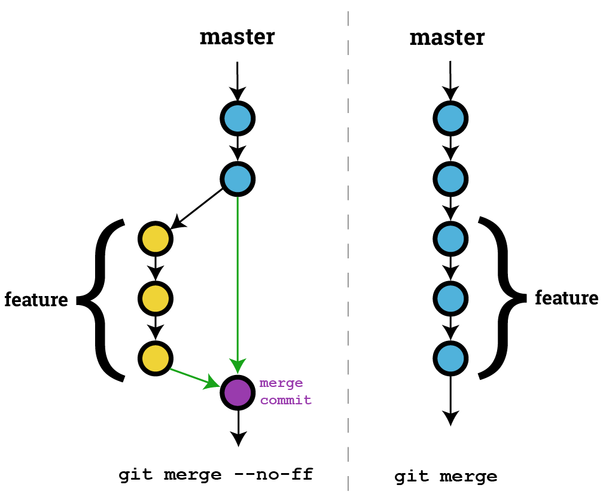

Let’s Git Metaphorical

Slide 9

Git Station
Pull Push Sync
Stage
Commit
New Branch
Pull Request
Checkout
Merge
Main
File Copy
Command
Stop Point

Slide 10

How-To Implement CI/CD
Option 1 (premium or PPU):
Git-enabled workspaces within a Power BI pipeline
Option 2 (pro or E5):
Repository and screenshare code reviews

Slide 11
PBI License & Git Matrix
 | Free | Pro / E5 | Premium Per User | Premium Capacity
Create .pbip file | X | X | X | X
Publish .pbix file |  | X | X | X
Create DevOps Repo | X* | X* | X* | X*
Use Git Operations | X* | X* | X* | X*
Use Power BI Pipelines |  |  | X | X
Use Git Integrated Workspaces |  |  | X | X

Slide 12

Demo Time!

Slide 13
Power BI Git-ting CI/CD: Part 2
Kristyna Hughes

Slide 14
Git Station
Pull Push Sync
Stage
Commit
New Branch
Pull Request
Checkout
Merge
Main
File Copy
Command
Stop Point

Slide 15
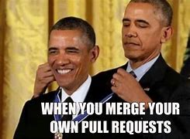
Do I really NEED PRs?
PR = short-hand for Pull Request
PRs allow for a final approval round before merging your code back into the main branch
Allows for better coding standard maintenance and accountability

Slide 16
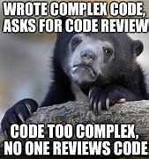
PR Etiquette
Make sure your code uses clear variables and naming conventions
Commit often and write clear commit messages
Put notes into your code to help future you and current reviewers

Slide 17
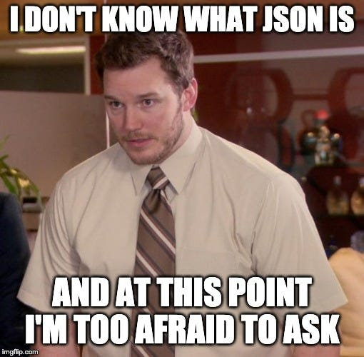
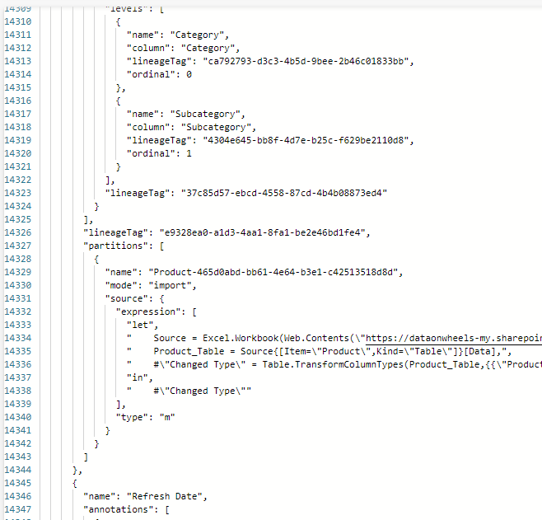
Reviewing PBIP PRs

Slide 18
Use PBI Service
DevOps isn’t quite the tool we are looking for
Power BI pipelines can offer us a better way to review visual changes to a report
We can use JSON and DevOps to quickly identify what has changed, even if we can’t visualize it
Add notes into the PR itself to help the review process

Slide 19

Revert – The Secret Sauce of Git
This is why having clear commit messages and small amounts of changes in each commit matters
Revert = undo all the changes within a commit and create a new commit. This can be done from any commit, not just the last change applied.
There are more options that can be used in a traditional development environment, but this is the easiest to use within DevOps

Slide 20
Demo Time!

Slide 21

Questions?

Slide 22

Don’t forget to connect, thanks for listening!
Blog: https://dataonwheels.wordpress.com/
Email: Kristyna@dataonwheels.com
Twitter: @data_dragoness
LinkedIn

